Slide 1
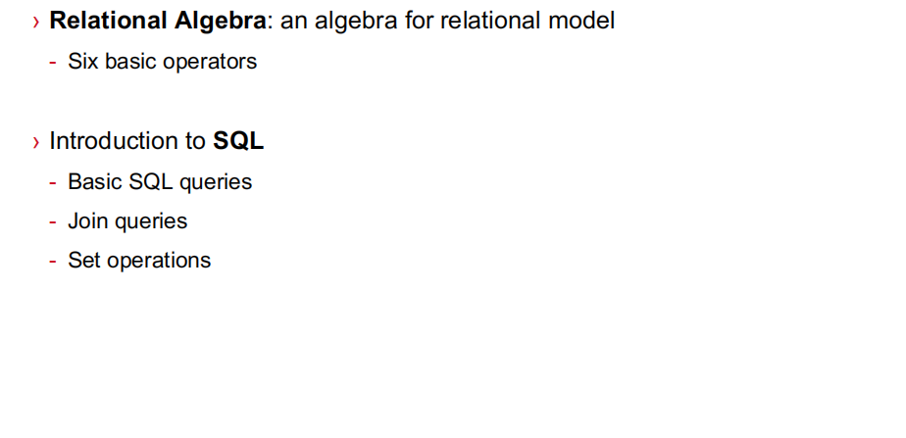
Outline of today

Slide 2
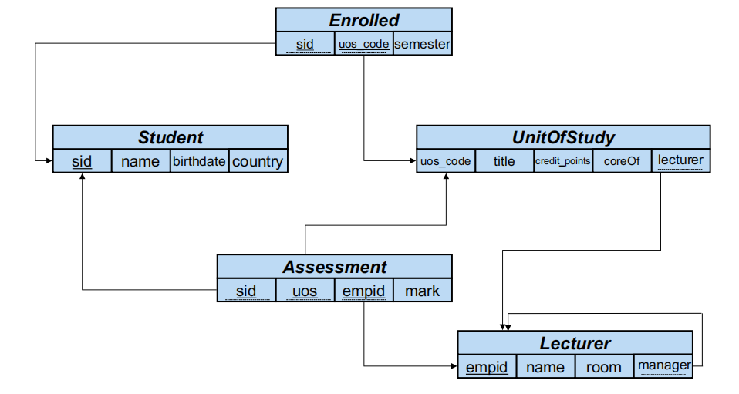
Flashback： Database Schema

Slide 3
Relational Algebra
Used to conceive SQL queries
Structured SQL queries

Slide 4
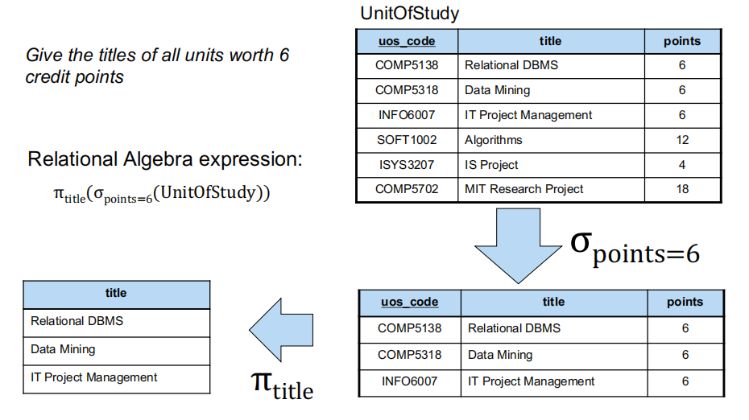
selection
projection

Slide 5
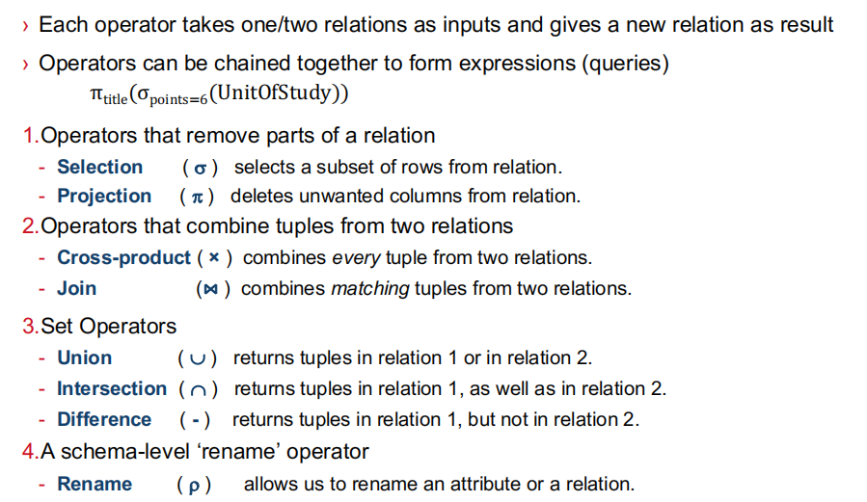

Slide 6
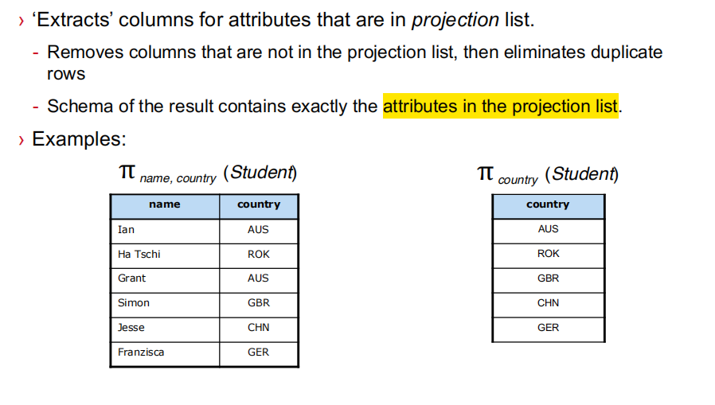
Projection

Slide 7
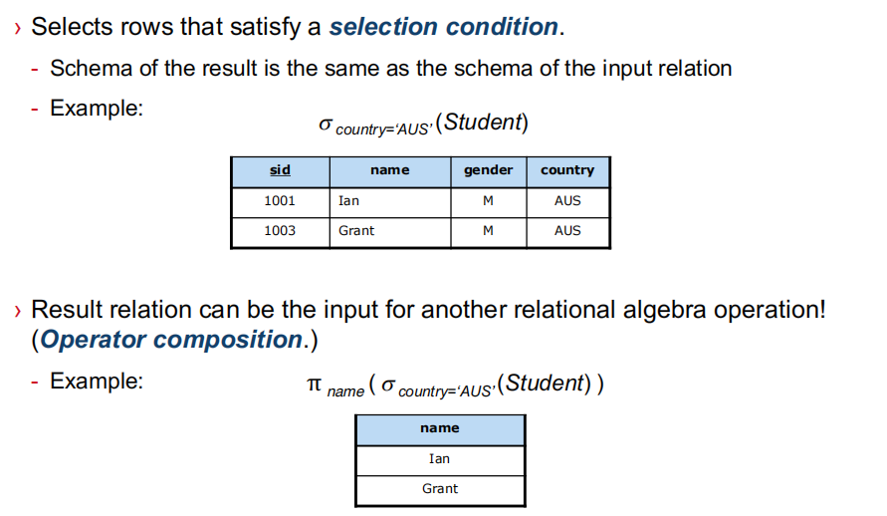
Projection

Slide 8
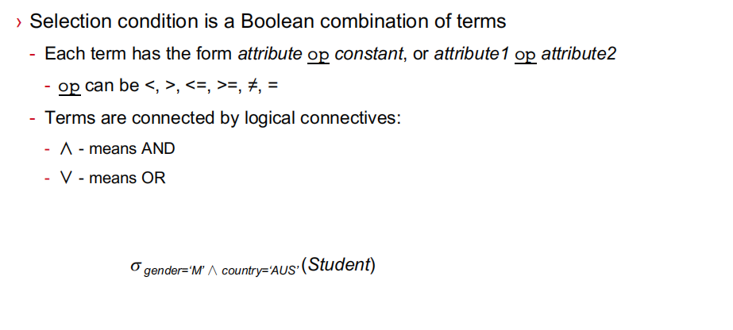
Selection Condition

Slide 9
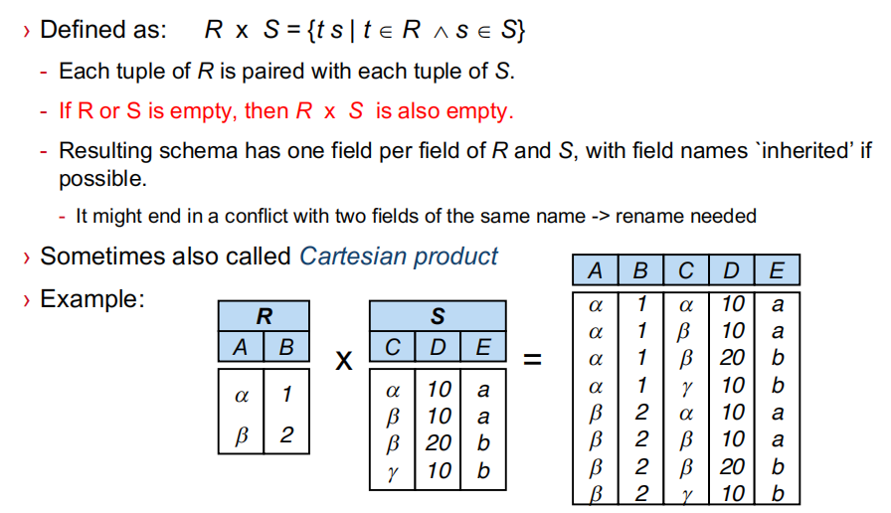
Cross Product (x)

Slide 10
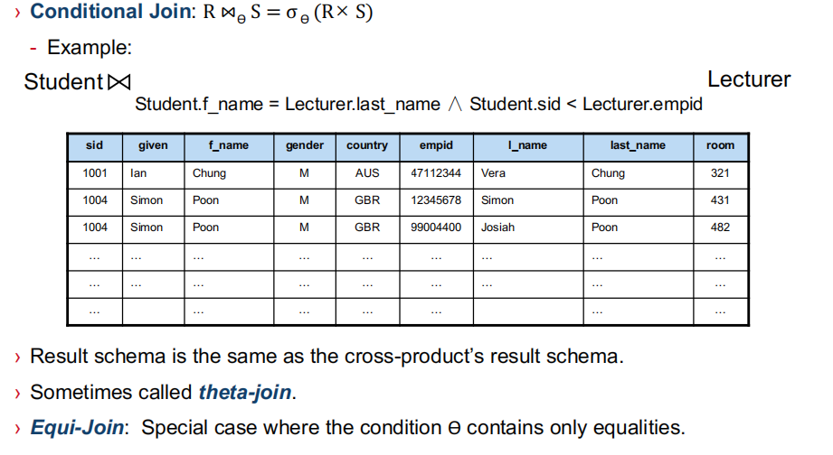

Slide 11
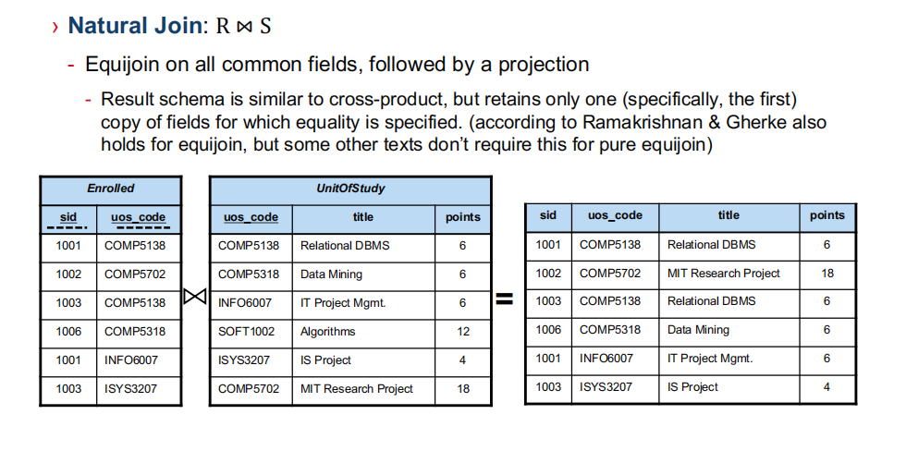

Slide 12





Slide 13
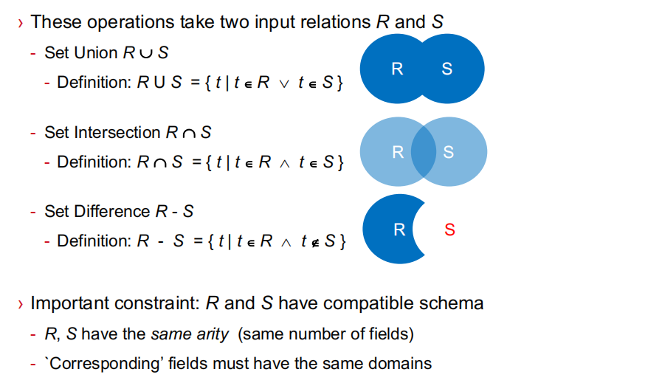
Set Operations

Slide 14
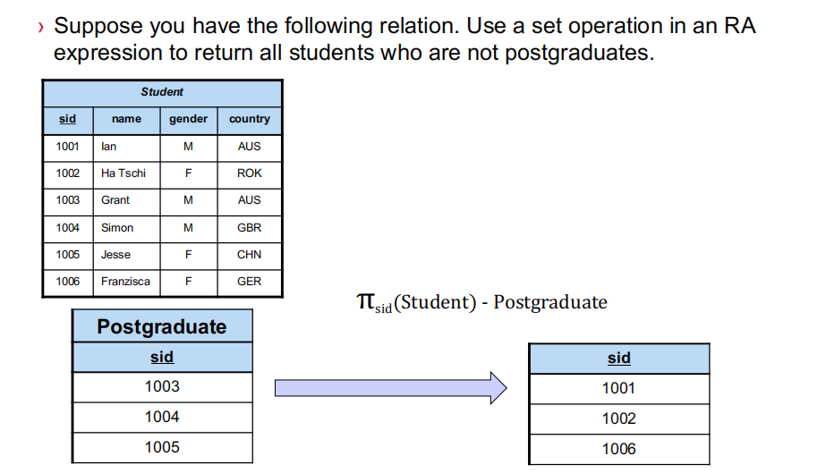
How about complete student information?

Slide 15
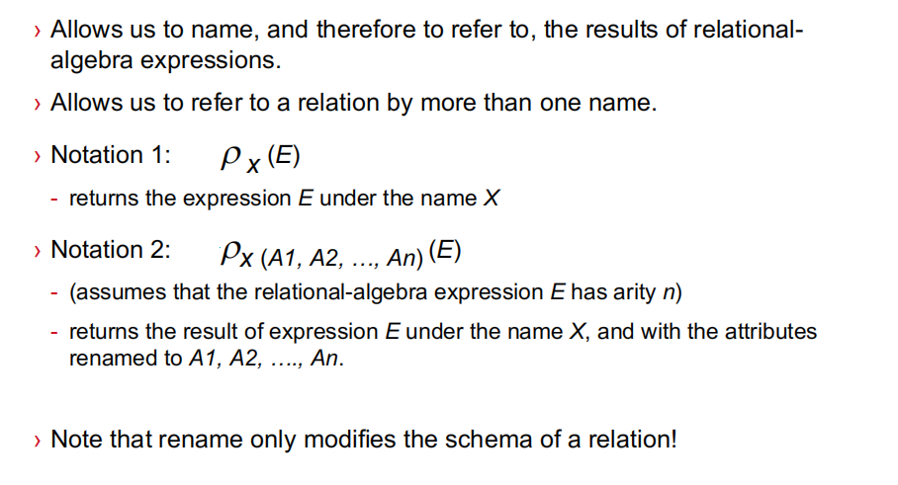

Slide 16
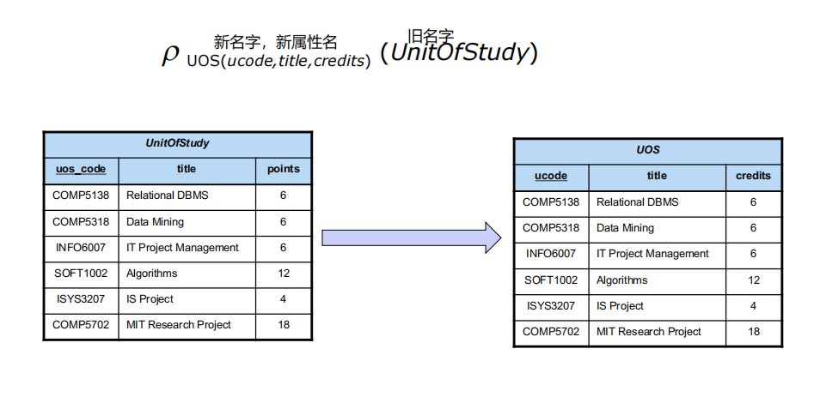
Rename operation

Slide 17
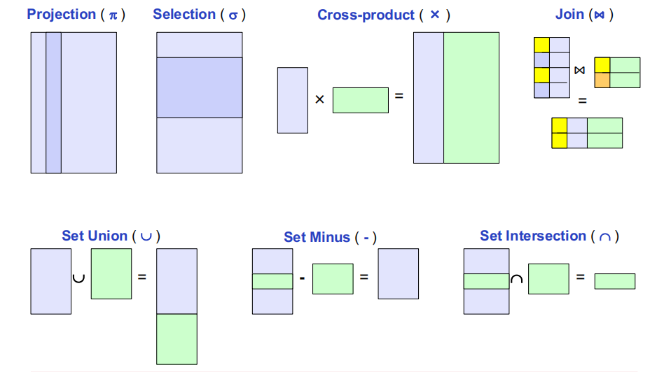

Slide 18
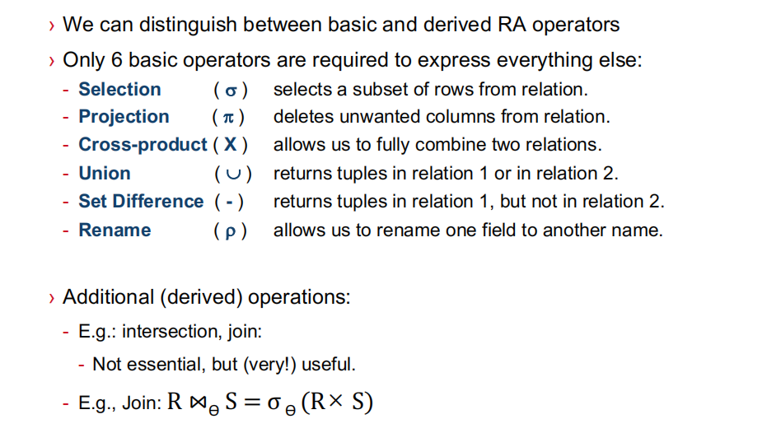
R - (R - S) = R∩S

Slide 19
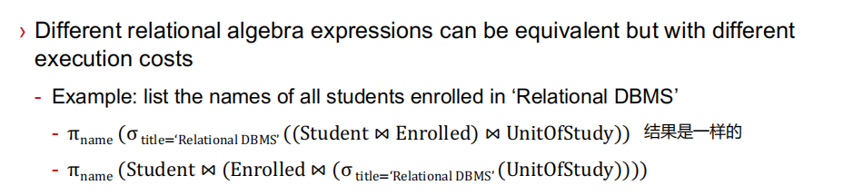
Remarks

Slide 20
Introduction to SQL

Slide 21
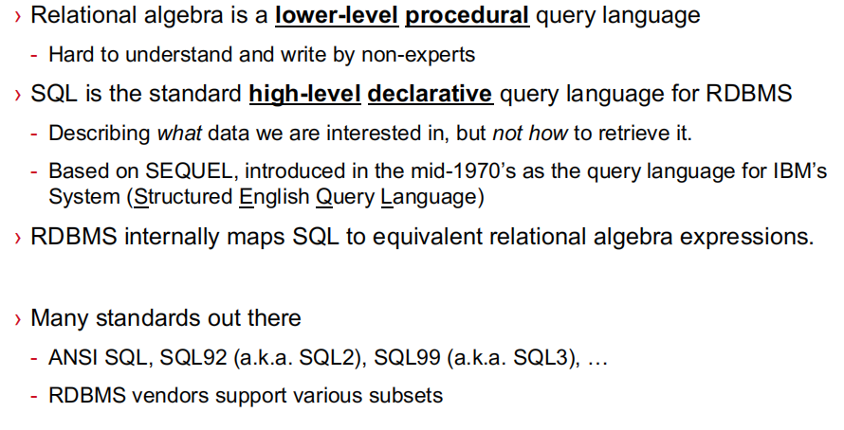

Slide 22
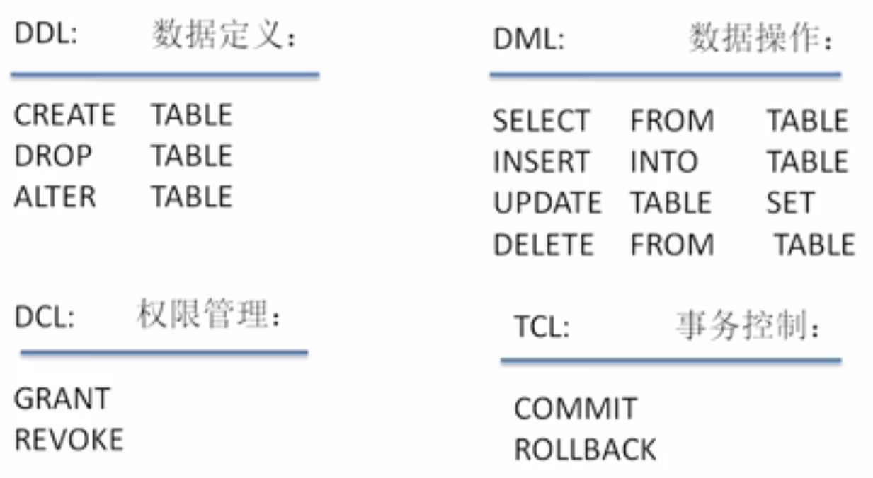
7.1 Introduction to SQL

Slide 23
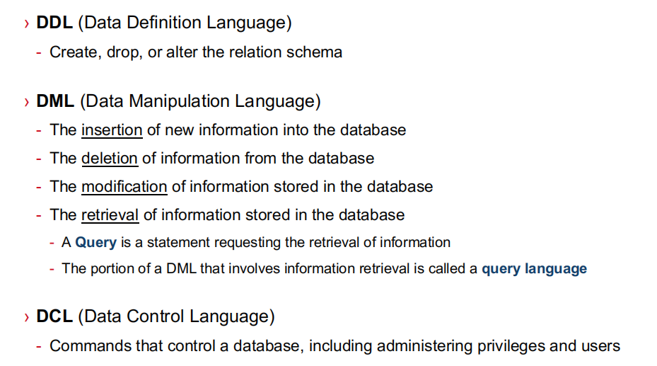

Slide 24
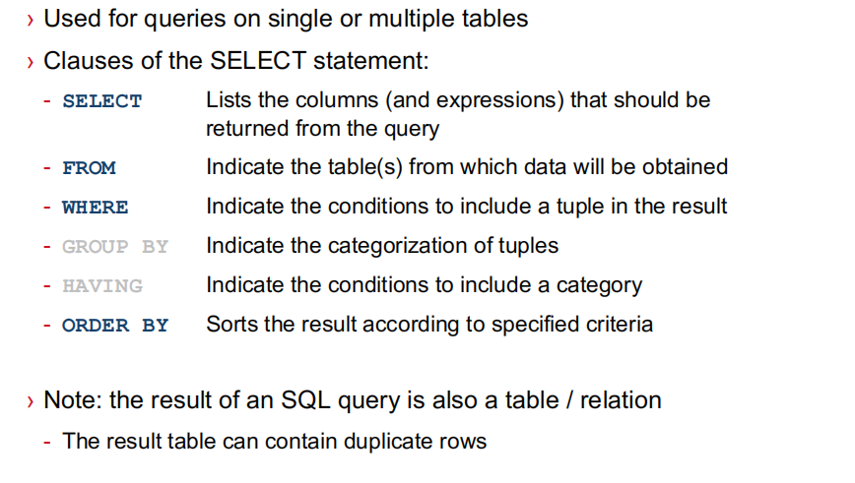
Select statement

Slide 25
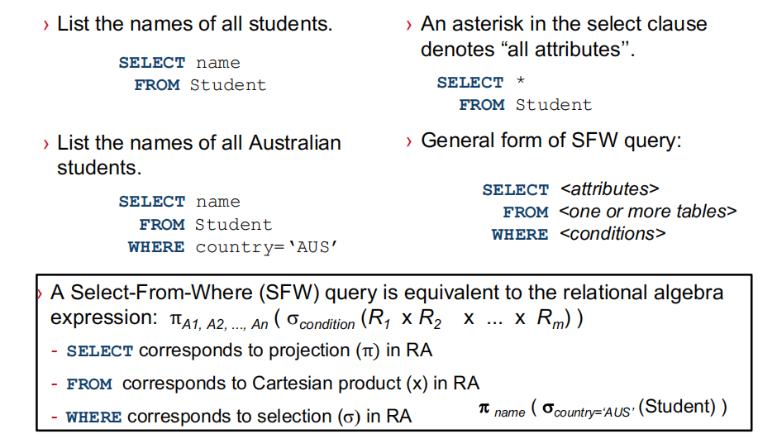
Select-From-Where (SFW) Queries

Slide 26
Exercise
1、select all the student name from student table.
2、select all the course name from course table.
3、select all the information of student Amy.

Slide 27
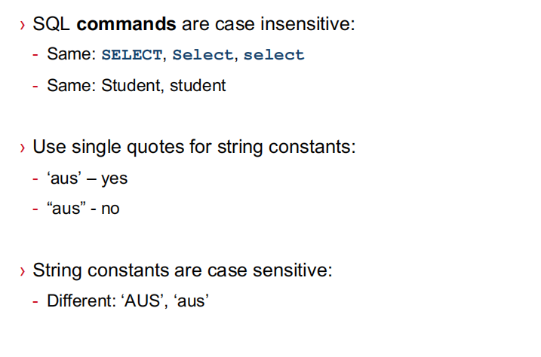
A Few Details

Slide 28
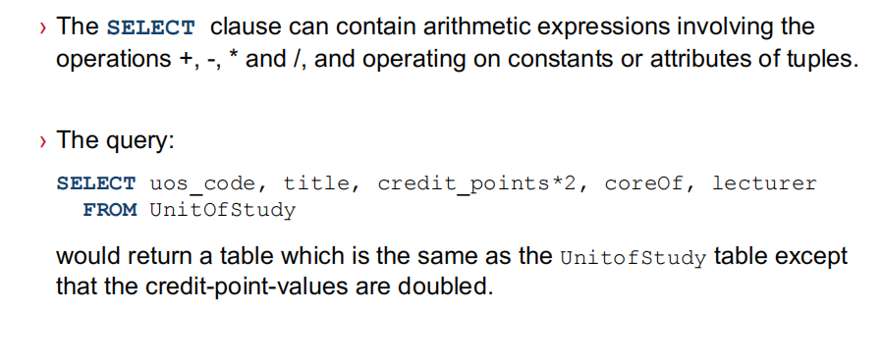
Arithmetic Expressions in Select Clause

Slide 29
Exercise
1、select the grade of all courses and the scores are 80% of the original scores.
2、select the results of Sid minus grade from enroll table.

Slide 30
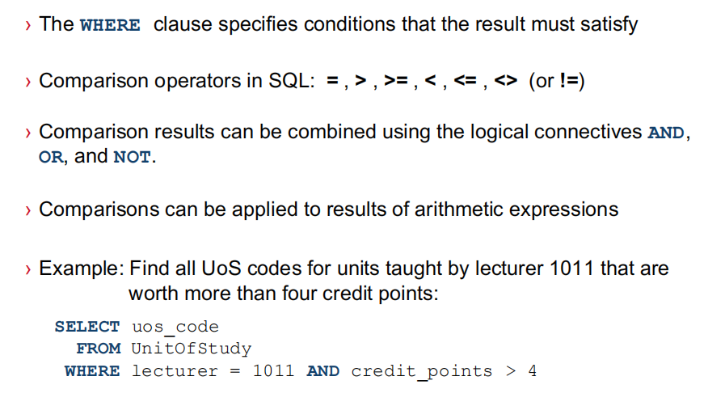
The Where Clause

Slide 31
Exercise
1、select the grade and Sid of the students whose scores are over 90.
2、select the grade and Sid of the students whose scores are over 90 in courseID 101.
3、select the grade and Sid of the students whose scores are over 90 in course ‘database’;

Slide 32
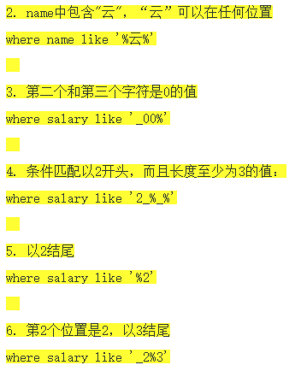
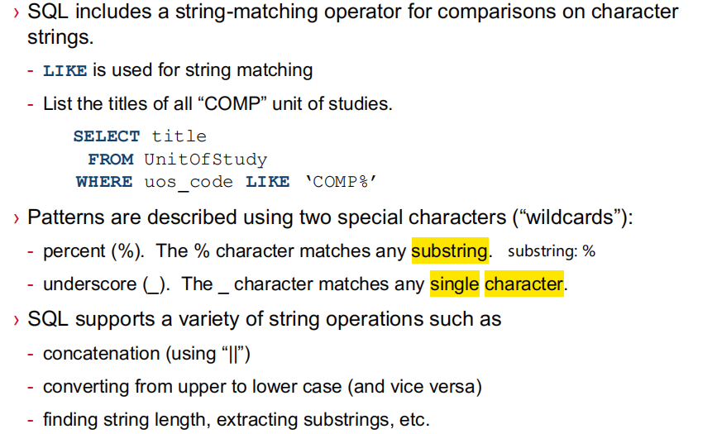
String Operations

Slide 33
Exercise
1、select the name of students whose name includes an ‘m’.
2、选择学生姓名里第二个字母为m的学生名，和这些学生的课程成绩。

Slide 34
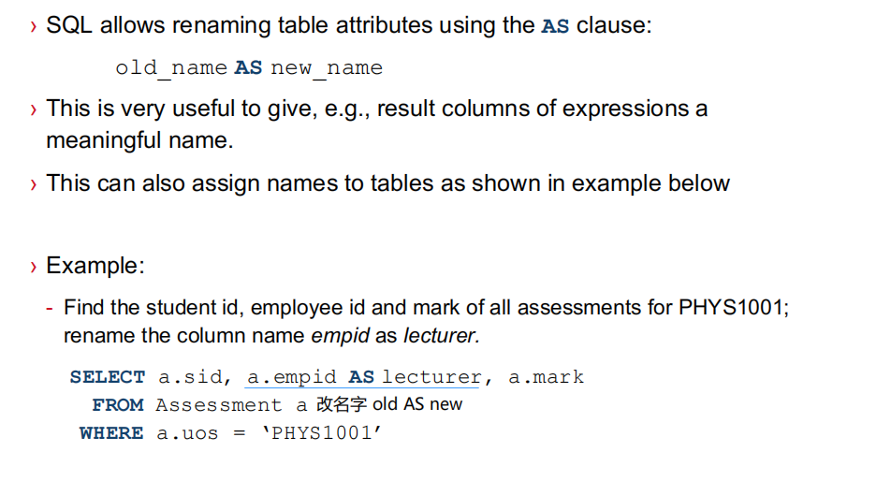
The Rename Operation

Slide 35
Exercise
1、select the contact-details of students and change the column name ‘contact-details’ to ‘phone and email’.

Slide 36
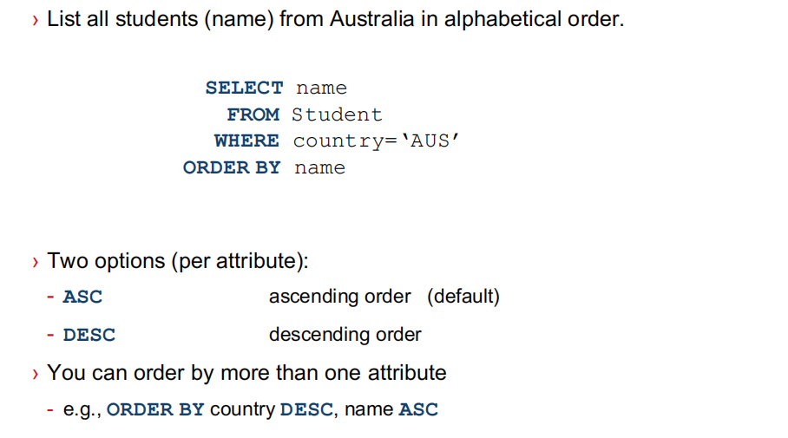
Order By Clause

Slide 37
Exercise
1、select the grade of students in CourseID 101 and order the grade in descending order.

Slide 38


Slide 39
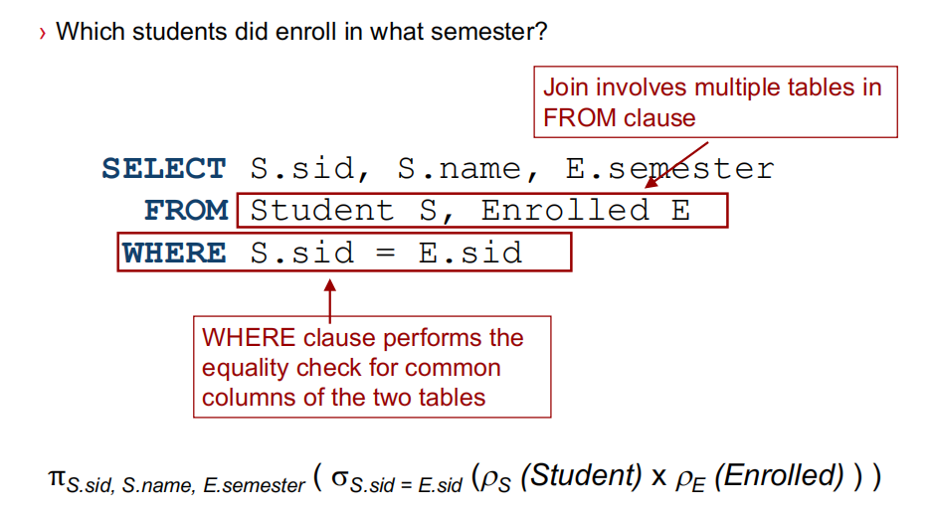
Join Example

Slide 40
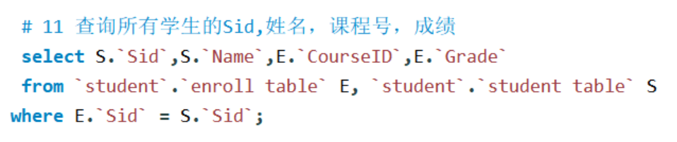
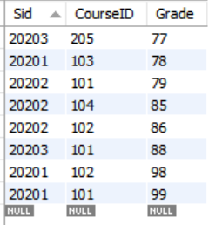
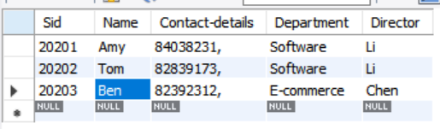
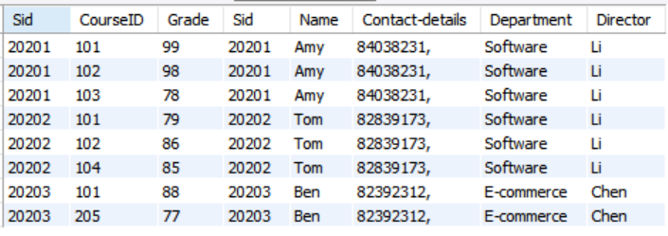
student table
Enroll table
以Sid把两个表格连接起来

Slide 41
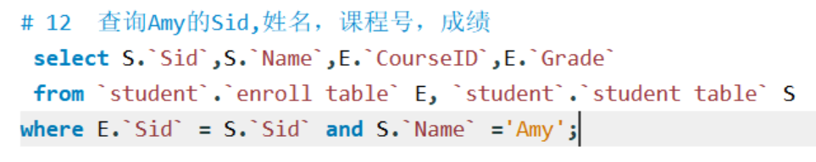
student table
Enroll table
以Sid把两个表格连接起来

Slide 42
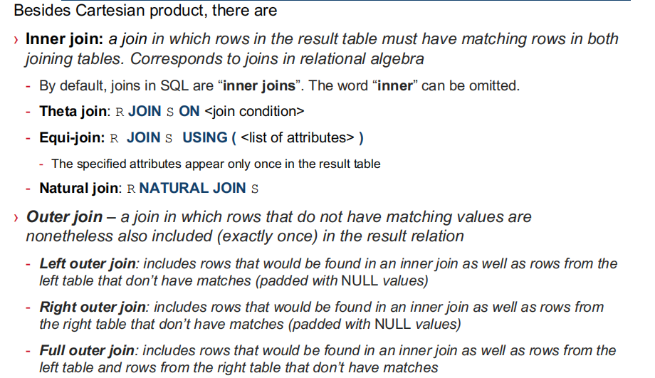
会产生笛卡尔积结果

Slide 43
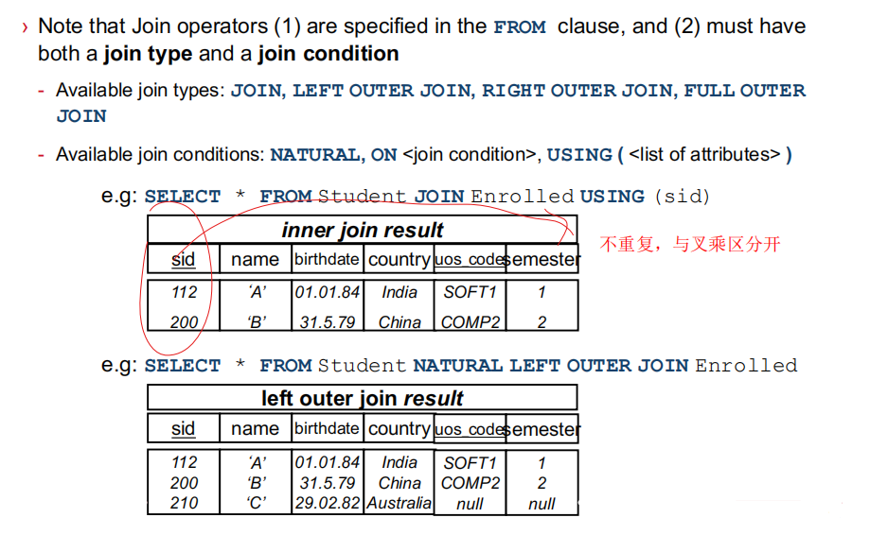
Natural join

Slide 44
Exercise
1、Use natural join to join the course table and enroll table.
2、Use （join using ）to join the course table and enroll table.
3、Use （join on ）to join the course table and enroll table.(可产生笛卡尔积效果)
select * from enroll table E join course table C on (E.CourseID = C.CourseID)
Please observe the differences between the 3 joing methods.

Slide 45
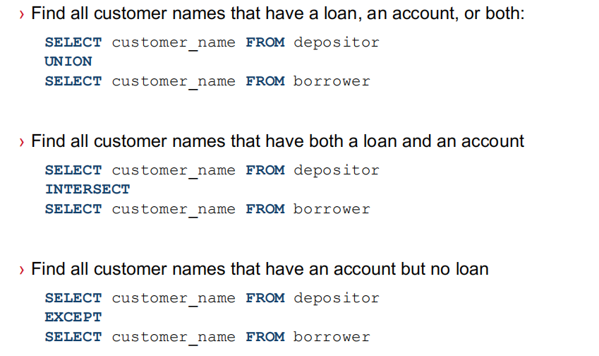
Examples of Set operations

Slide 46
Exercise
1、select the students’ name who enroll in course 101 or course 102.
筛选出选了 101这门课 或102这门课的学生的学生名字
思考题：select the students’ name who enroll in course 101 and course 102.
筛选同时选了101和102这两门课学生的学生名字

Slide 47
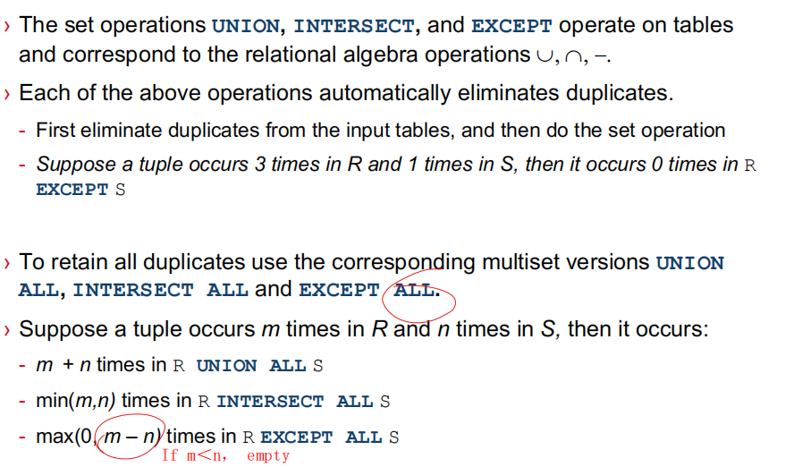
Set operations

Slide 48


Use union
Use where

Slide 49

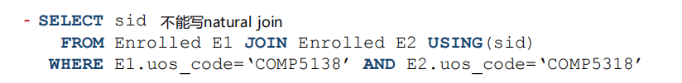
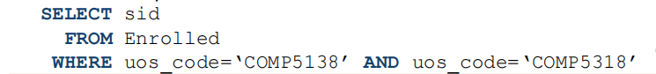
Use intersect
Same？
Ø

Slide 50
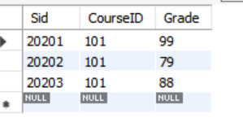
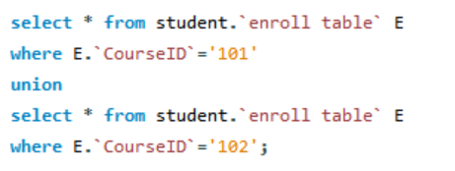
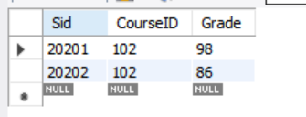
两者结果取并集

